Slide 1
Big Data Class Presentation
Topic 7
Input and Output
Fancier Output Formatting
Formatted String Literals
The String format() Method
Manual String Formatting
Old String Formatting

Slide 2

Input and Output in Python
What is Input in Python?
Allows user interaction
Uses the input() function
Returns data as a string
Example

Slide 3

Input and Output in Python
What is Output in Python?
Displays information to the screen
Uses the print() function
Supports text, numbers, and variables
Example

Slide 4
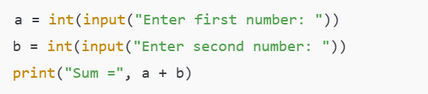
Input and Output in Python
Example: Add Two Numbers
Summary
input() takes user input
print() displays output
Input is always a string, convert when needed

Slide 5
Fancier Output Formatting
Why formatting is important
Enhances readability
Useful in data presentation
Helps align data in reports, logs, and table

Slide 6
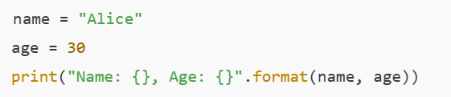
Fancier Output Formatting str.format() Method
Features:
Supports positional and keyword arguments
Can format numbers, align text, pad with characters

Slide 7

Fancier Output Formatting f-strings (Python 3.6+)
Advantages:
Cleaner syntax
Supports full expressions
Very readable

Slide 8

Fancier Output Formatting
Alignment and Padding
Specs:
< Left-align
> Right-align
^ Center-align
Padding with custom characters: f"{value:*^10}"

Slide 9

Fancier Output Formatting
Number Formatting
Options:
Thousands separator: :,
Fixed decimals: .2f
Percentages: {:.2%}

Slide 10
Fancier Output Formatting
Formatting with format() Specifiers
Style:
Alignment and width
Float precision
Hex, binary, octal with format codes: x, b, o

Slide 11

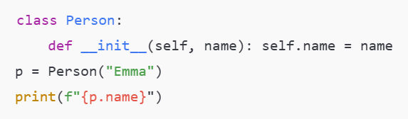
Fancier Output Formatting
Dictionary and Object Access

Slide 12
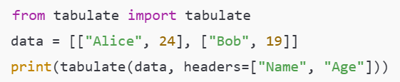
Fancier Output Formatting
Using textwrap and tabulate (External Libraries)
Use Cases:
Tables for CLI reports
Multi-line text with textwrap.fill()

Slide 13

Fancier Output Formatting
Unicode & Emojis for Fancy Displays
Format /Uxxxx
Use \u for Unicode characters
Emojis add visual appeal to CLI tools

Slide 14

Fancier Output Formatting
ANSI Escape Codes (For Colorful Output)
Common Codes:
\033[91m – Red
\033[92m – Green
\033[1m – Bold
\033[0m – Reset

Slide 15
Fancier Output Formatting
Basic and Advanced str.format()
Common Codes:
\033[91m – Red
\033[92m – Green
\033[1m – Bold
\033[0m – Reset

Slide 16
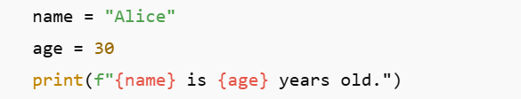

Fancier Output Formatting f-Strings (Formatted String Literals)
Introduced in Python 3.6, f-strings provide a concise and readable way to embed expressions inside string literals.
Example:
Supports:
- Expressions
- Formatting options (e.g., float precision, number formatting)

Slide 17

Fancier Output Formatting str.format() Method
Allows positional and keyword formatting and named placeholders in strings.
Example:
Keyword example:
Can specify formatting:

Slide 18
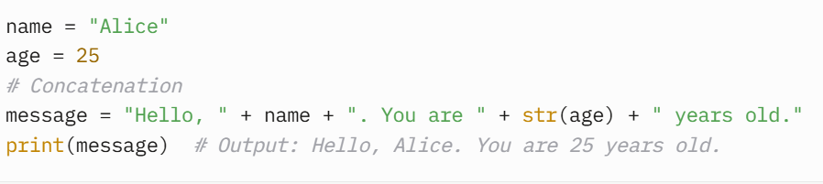
Fancier Output Formatting
Manual String Formatting
Manual string formatting refers to constructing strings by concatenating strings and values using operators like + or by directly embedding variables. It’s a basic, less structured approach that relies on explicit string manipulation.
Key Characteristics
Uses string concatenation (+) or direct insertion of values.
No specific formatting syntax or placeholders.
Error-prone, especially when mixing types (e.g., strings and numbers).
Not recommended for complex formatting due to readability and maintenance issues.

Slide 19
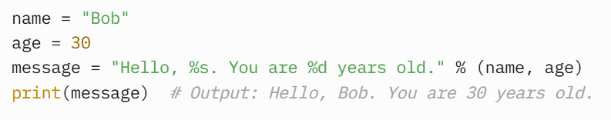
Fancier Output Formatting
Old String Formatting ( %-formatting)
Old string formatting, also known as %-formatting or printf-style formatting, uses the % operator to insert values into a string with placeholders. It was the primary method in Python 2 and early Python 3.
Key Characteristics
Uses % to define placeholders (e.g., %s for strings, %d for integers, %f for floats).
Supports basic formatting options like padding, precision, and alignment.
Less readable and more verbose than modern methods (f-strings or str.format()).
Largely deprecated in favor of newer methods but still works in Python 3.
Common Placeholders
%s: String (or any object with a string representation).
%d or %i: Integer.
%f: Floating-point number.
%x or %X: Hexadecimal.

